Slide 1
DWDM Network Planning Tool
(Training-Level Feasibility Analyzer using FastAPI & React)
Presented by:Girish CK
Project Type:Seminar + Full-Stack Implementation
Technology Stack: Python (FastAPI) React (Frontend UI)
Optical Power Budget ModelingDate:(Insert presentation date)

Slide 2
Agenda
Planning Metrics
Power Budget & Rx Power
OSNR (Threshold & Margin)
System Design (FastAPI + React)
API ContractUI
ScreensEdge Cases
Lessons Learned
Future Work
Live Demo & Q&A

Slide 3
Introduction to DWDM
These are the fundamental concepts required to understand DWDM network planning:
Wavelengths DWDM carries multiple optical channels over a single fiber.
Each channel operates at a different wavelength (λ).Enables high-capacity transmission.
SpansA span is the fiber segment between two optical elements. Signal power reduces over distance due to attenuation.
May include connectors, splices, and amplifiers.
ROADMs Reconfigurable Optical Add-Drop Multiplexers.
Allow dynamic routing of wavelengths. Enable flexible optical network design.

Slide 4
Problem Statement
The following parameters directly affect DWDM link feasibility:
Fiber Attenuation Signal loss per kilometer (dB/km).Increases with distance. Primary contributor to total link loss.
Connectors Each connector introduces insertion loss. Accumulates across the link.
Splices Fusion or mechanical joints in fiber. Add small but cumulative loss.
EDFA (Erbium-Doped Fiber Amplifier) Compensates for fiber loss by amplifying signal power. Includes gain and practical penalties.

Slide 5
Project Objective
Power Budget & Rx Power(Formula + Example)
What is Power Budget? Power Budget = Tx Power − Receiver Sensitivity
It represents the maximum allowable loss in the link.
Total Link LossTotal Loss =(Fiber Loss + Connector Loss + Splice Loss − Amplifier Gain)Where: Fiber Loss = Length × Attenuation Connector Loss = Number of connectors × Loss per connector Splice Loss = Number of splices × Loss per splice
Received PowerRx Power = Tx Power − Total LossPower condition is satisfied if:Rx Power ≥ Receiver Sensitivity
Example Given: Tx Power = 2 dBm Receiver Sensitivity = −28 dBm
Power Budget = 2 − (−28) = 30 Db Assume Total Loss = 22 dB Rx Power = 2 − 22 = −20 dBm Since −20 ≥ −28 → Power PASS

Slide 6
Key Optical Planning Parameters
OSNR(Simplified Threshold & Margin)
What is OSNR?OSNR (Optical Signal-to-Noise Ratio) measures the quality of the optical signal. It represents the ratio of signal power to noise power. Higher OSNR → Better signal quality.
Simplified OSNR Estimation (Training Model)Estimated OSNR =Tx Power − Total Loss + Total Amplifier Gain − Noise Penalty
OSNR Margin OSNR Margin = Estimated OSNR − OSNR Threshold
Feasibility Condition If OSNR Margin ≥ 0 → OSNR PASS If OSNR Margin < 0 → OSNR FAIL Both conditions must be satisfied: Rx Power ≥ Receiver Sensitivity OSNR Margin ≥ 0Only then → Link is Feasible
Example Assume: Estimated OSNR = 20 dB OSNR Threshold = 18 dB OSNR Margin = 20 − 18 = 2 dB Since margin ≥ 0 → OSNR PASS

Slide 7
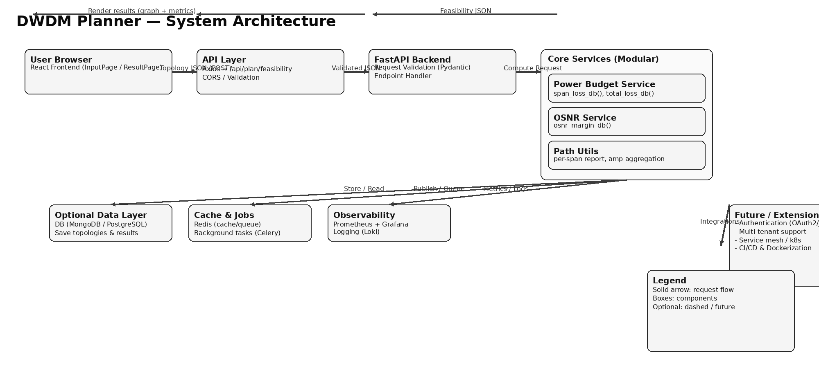
System Architecture

Slide 8
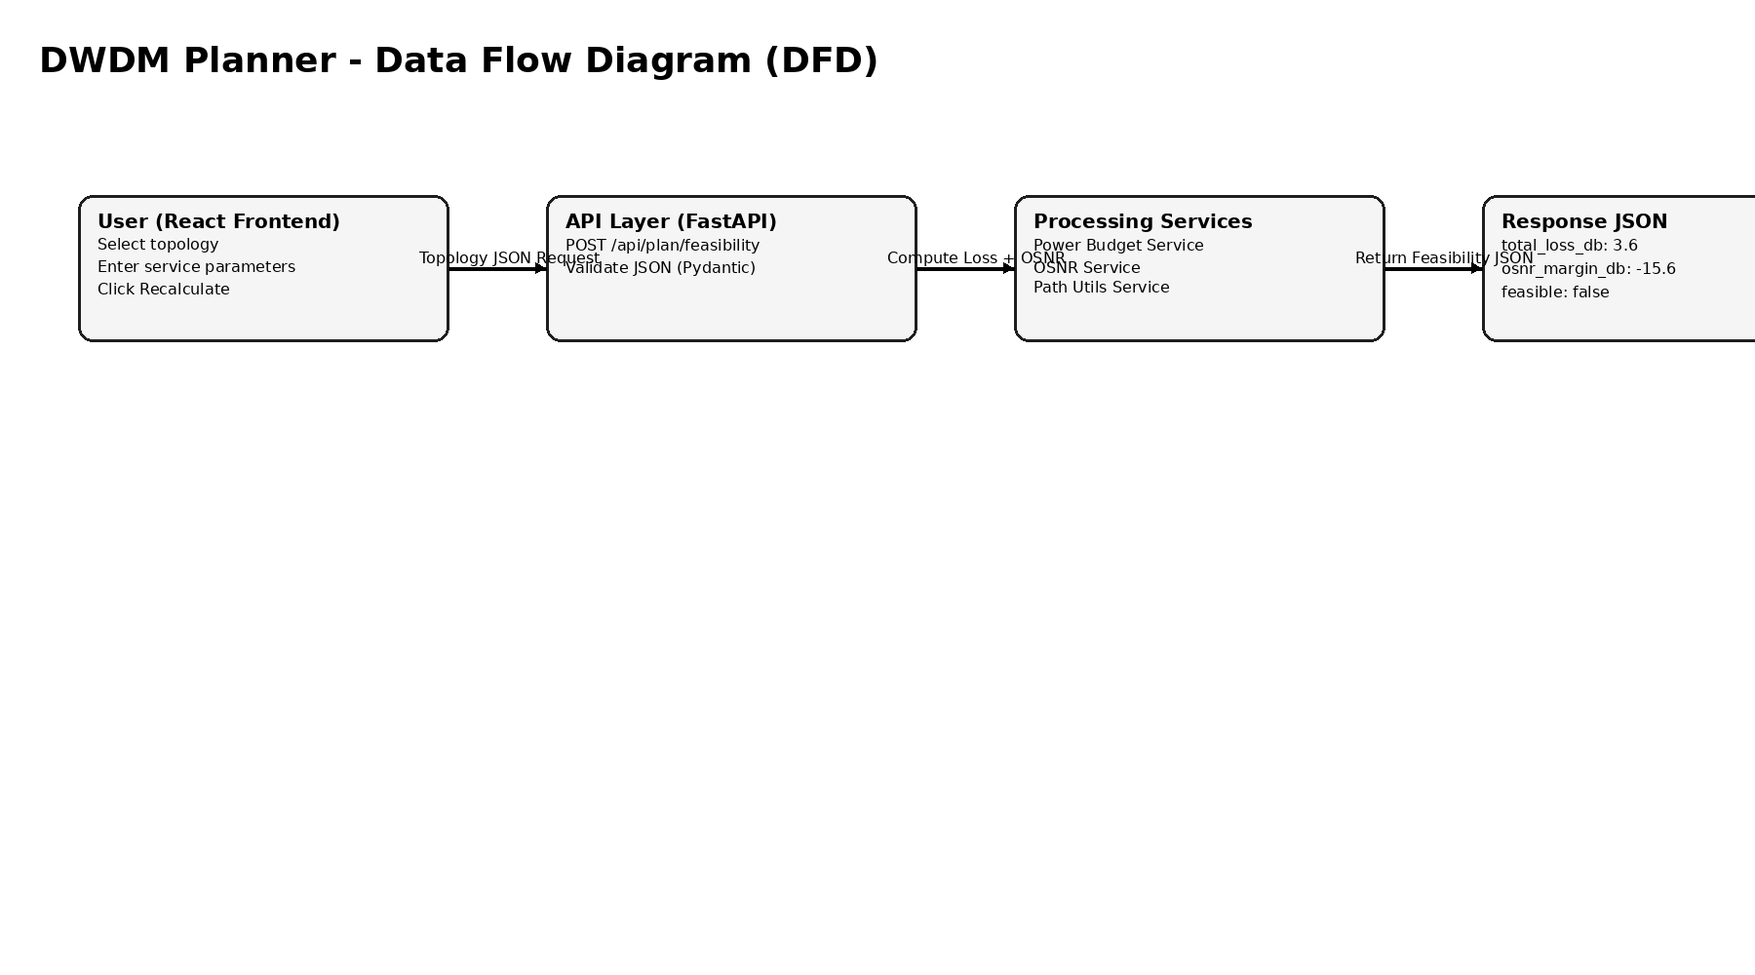
Data Flow Diagram

Slide 9
API Contract
Endpoint Information
HTTP Method: POST
URL: /api/plan/feasibility
Content-Type: application/json
This shows you understand REST design.
Request Structure
{ "nodes": [ { "id": "A", "label": "Site A" }, { "id": "B", "label": "Site B" } ], "spans": [ { "from": "A", "to": "B", "length_km": 50, "connectors": 2, "splices": 6, "amplifier_gain_db": 10 } ], "service": { "tx_power_dbm": 0, "receiver_sensitivity_dbm": -26, "osnr_threshold_db": 18 }, "assumptions": { "fiber_atten_db_per_km": 0.22, "conn_loss_db": 0.5, "splice_loss_db": 0.1, "noise_penalty_db": 3.0, "amp_penalty_db": 1.0
}}
Response Structure
{ "total_loss_db": 3.6, "tx_power_dbm": -3.6, "osnr_margin_db": -15.6, "feasible": false, "per_span": [ { "span_index": 0, "from": "A", "to": "B", "length_km": 50, "loss_db": 3.6
} ],
"assumptions_used": { "fiber_atten_db_per_km": 0.22, "conn_loss_db": 0.5, "splice_loss_db": 0.1, "noise_penalty_db": 3.0, "amp_penalty_db": 1.0
}}

Slide 10
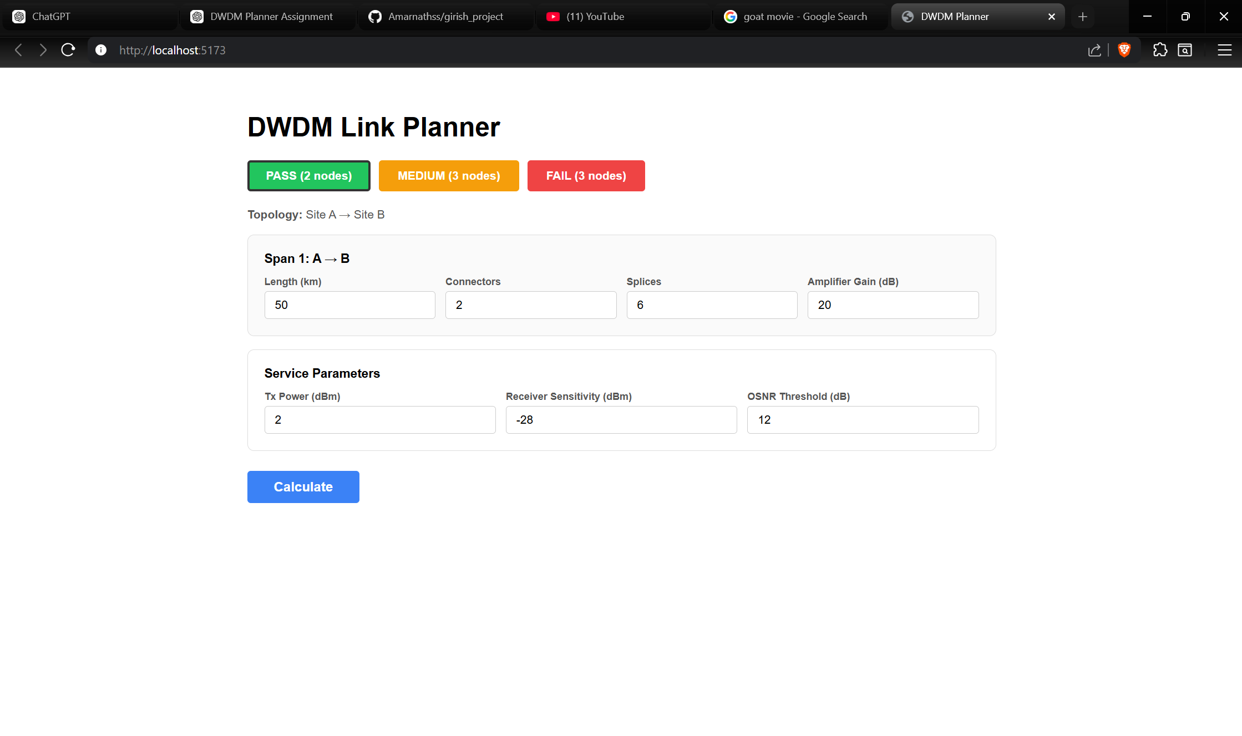
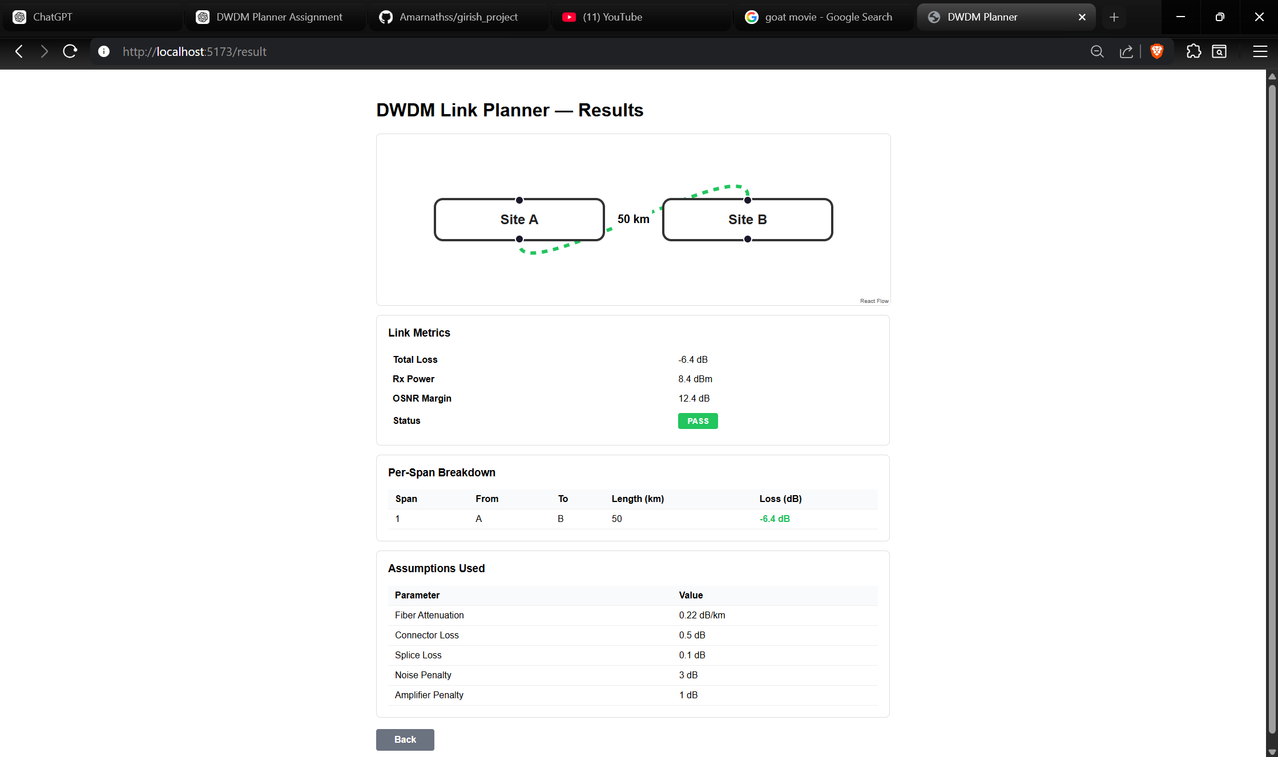
pics

Slide 11
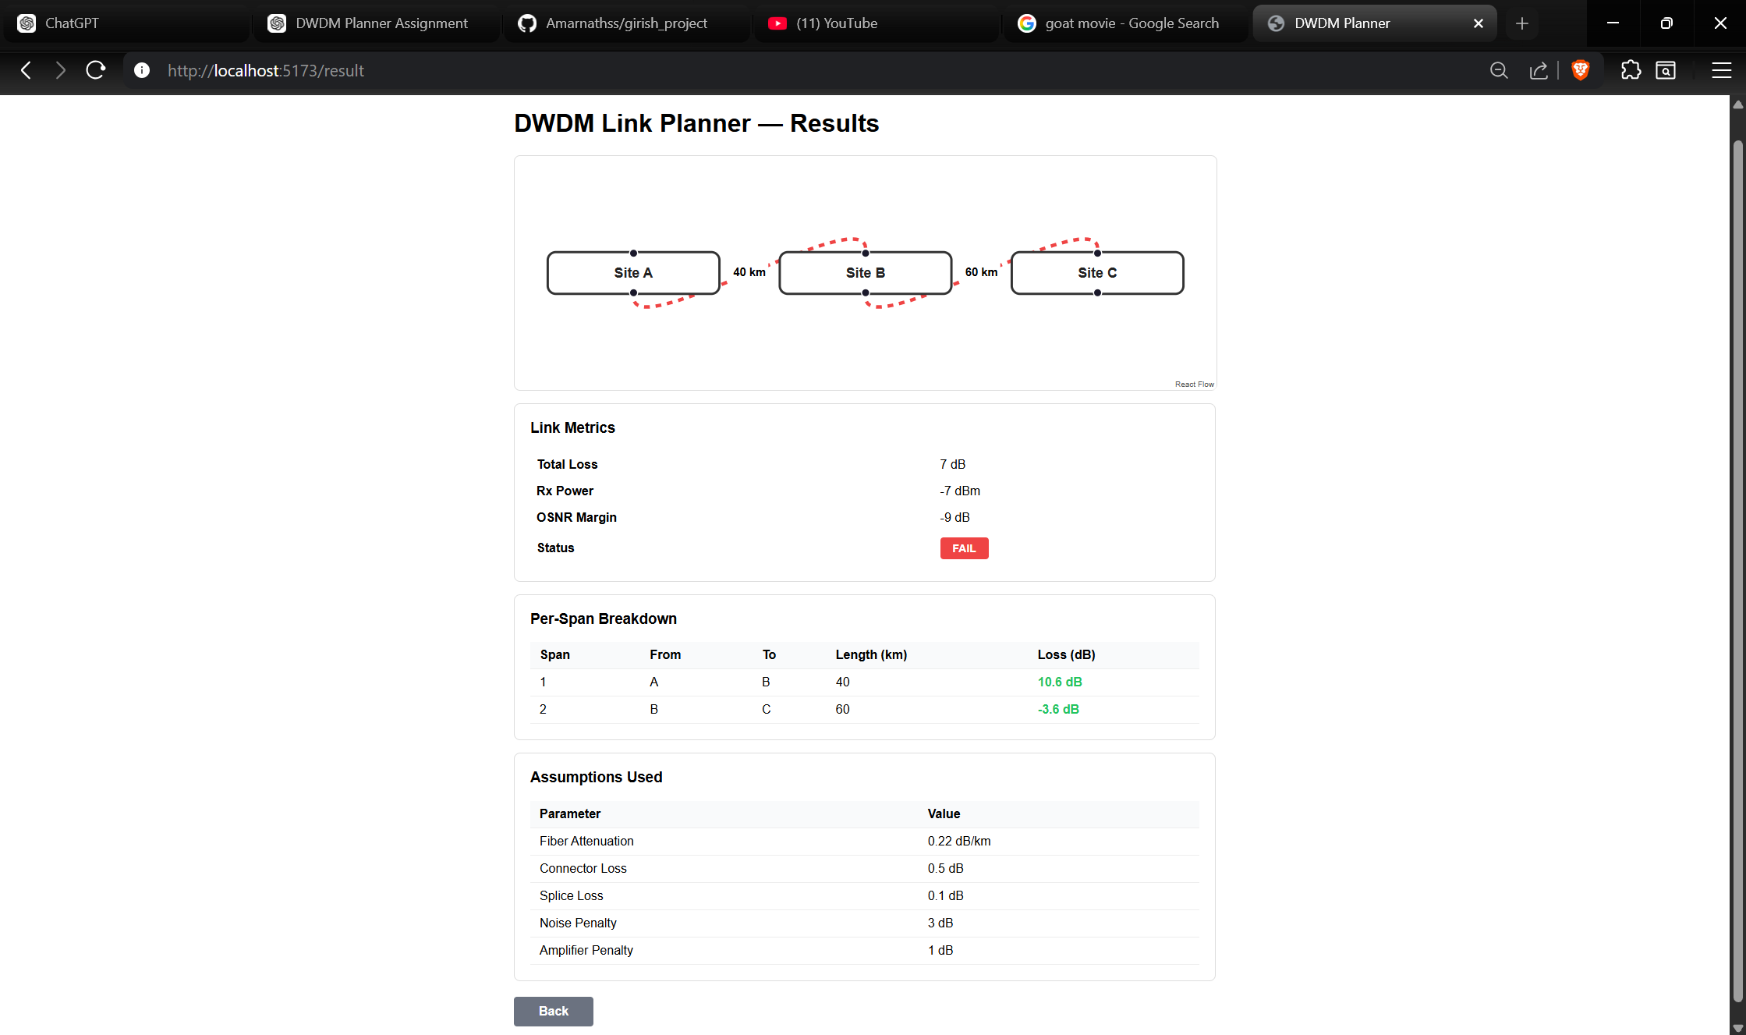
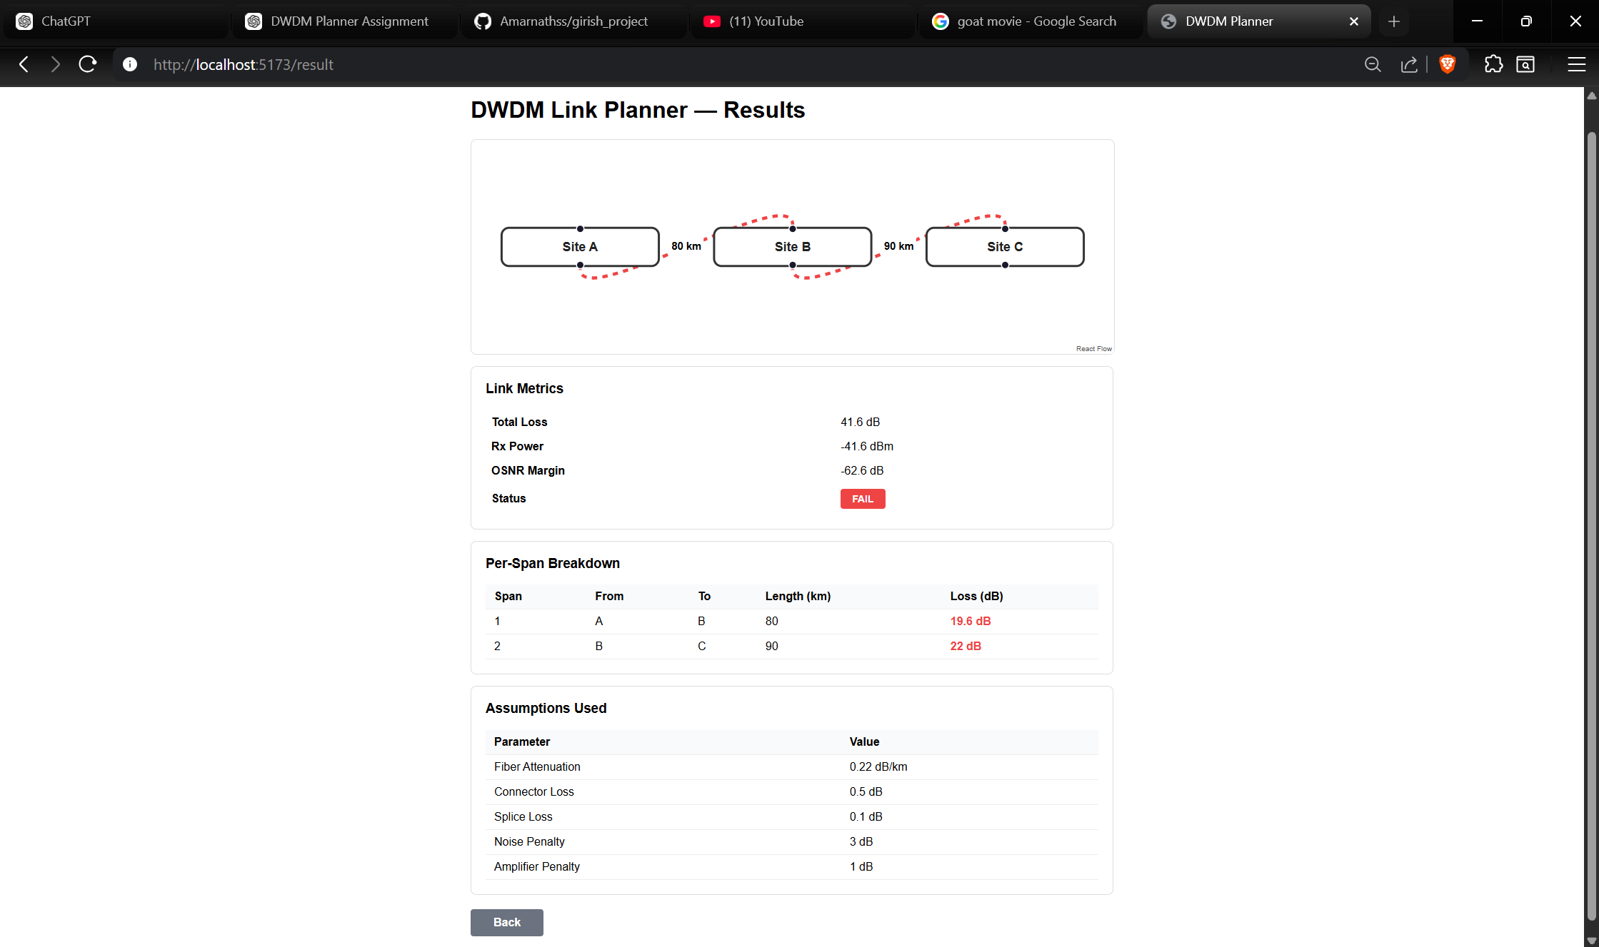

Slide 12
Edge Cases
The planner was tested against critical boundary conditions to ensure robustness.
Long Spans Large fiber length increases attenuation. Total loss may exceed power budget. Can result in Rx Power below sensitivity
No Amplifiers No gain compensation for fiber loss. High probability of power failure over long distances.
Receiver Sensitivity Limits Even if OSNR is acceptable, Rx Power must still be above sensitivity.
High OSNR Threshold Stricter modulation formats require higher OSNR. May cause OSNR failure even if power is sufficient.

Slide 13
Future Work
The current implementation is a simplified training model. Future enhancements can improve realism and scalability.
Flex-Grid Support Support variable channel spacing Enable flexible spectral allocation Improve spectral efficiency
Modulation-Aware Planning Different modulation formats (QPSK, 16QAM, etc.)Dynamic OSNR thresholds based on modulation Capacity-aware feasibility checks
Regenerator (Regen) Planning Identify locations requiring signal regeneration Support multi-span long-haul planning Improve long-distance network design
Telemetry Integration Use real-time network performance data Compare planned vs actual link metrics Enable adaptive optimization

Slide 14
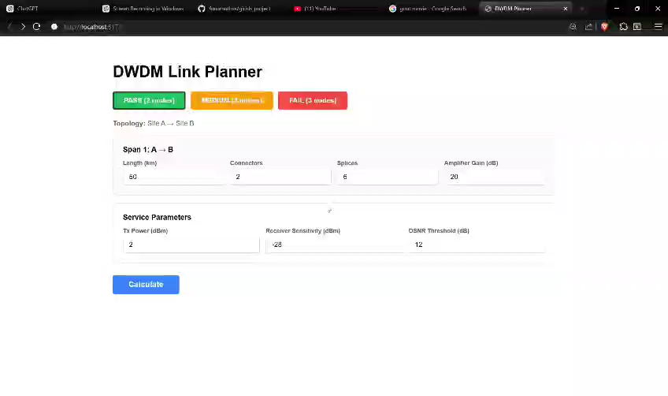
demo

Slide 15
Q&A
Questions & Discussion
Clarifications on power budget or OSNR logic
Architecture or implementation details
Design decisions and assumptions
Possible improvements or extensions

Slide 16
References
References
Basic DWDM Concepts (Training Notes)
FastAPI Documentation
React Documentation
Axios Documentation
React Flow Documentation

Slide 17
THANK YOU

